Slide 1
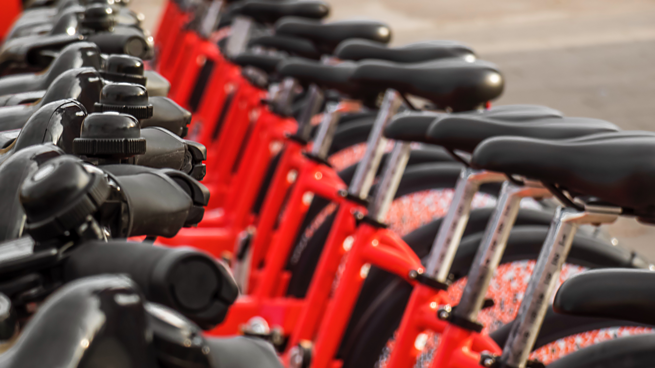
Comprehensive GIS-Based Method for Optimal Bikeshare Station Siting in Iowa City, IA
Hannah DeBruin – University of Minnesota
CEGE 8200 Seminar: Transportation
December 2nd, 2022

Slide 2
Presentation Format
Introduction
Methodology Overview
Input Factors
Weights of Input Factors
Final Results
Future Improvement
Hannah DeBruin

Slide 3
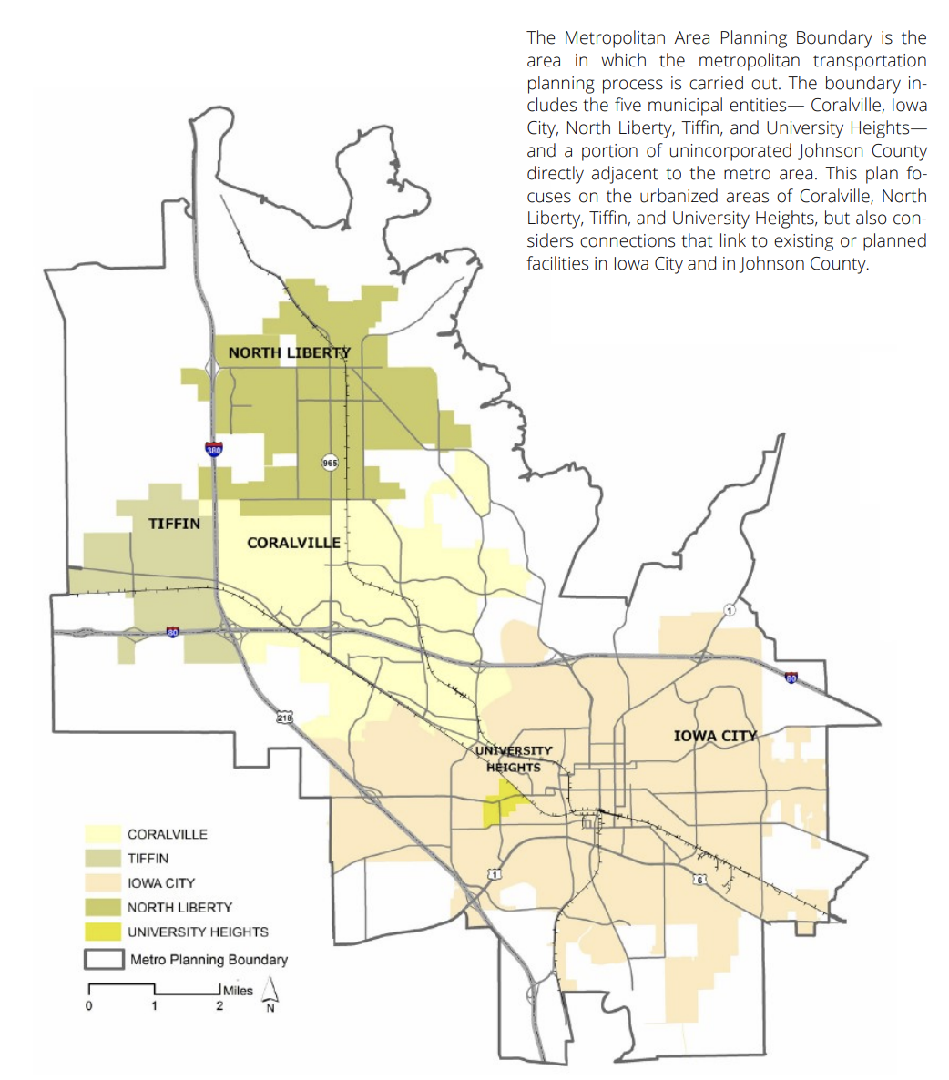

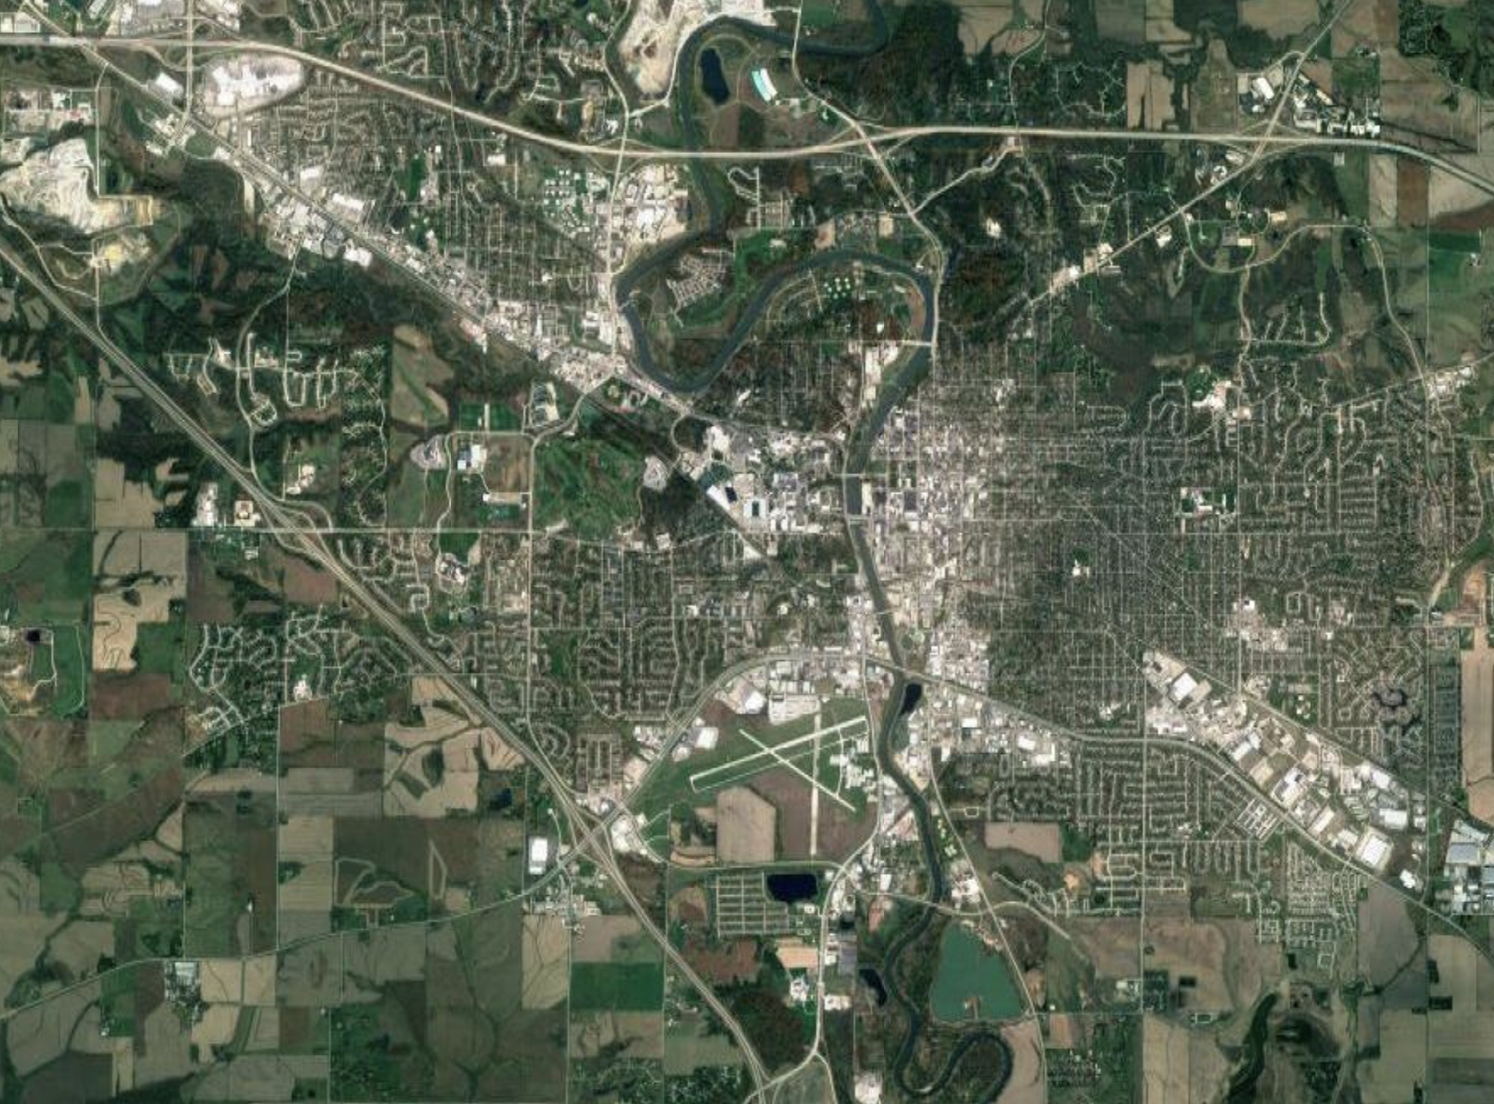

Introduction – Iowa City
Population: 74,596
University of Iowa Student Population: 33,334
Urbanized Area Population: 171,491
Hannah DeBruin

Slide 4

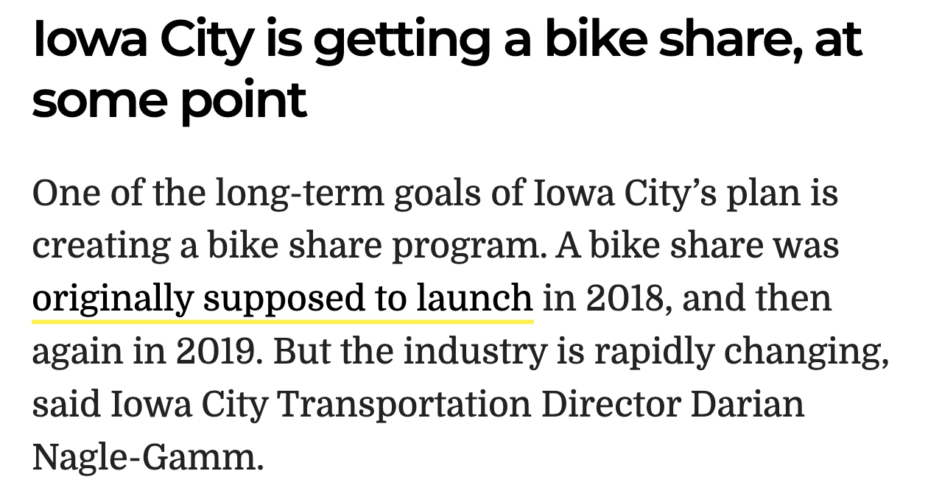
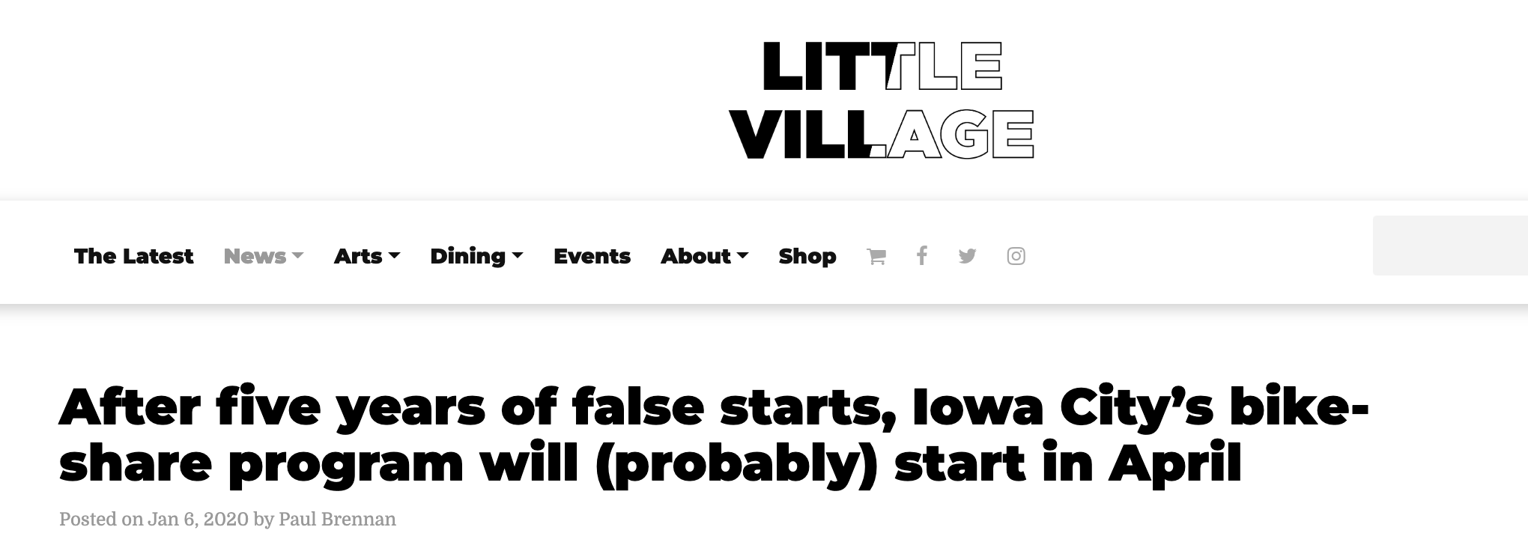
Introduction – Iowa City
[Little Village, Nov 2021]
Hannah DeBruin
Notes:
2015 – city and university started first partnership, but technology was evolving from docked to dockless systems, put project on hold
2018– put out bid for dockless version, began working and company wanted to use e-scooters, contract never concluded
2019- contracted with different mobility company, which was bought out by another mobility company, then faced supply chain shortages during the pandemic– contract basically halted again

Slide 5


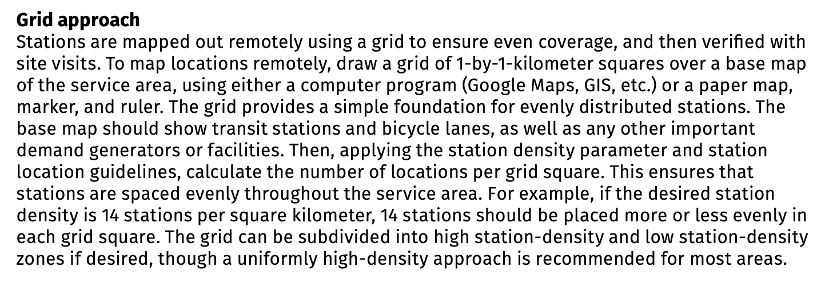
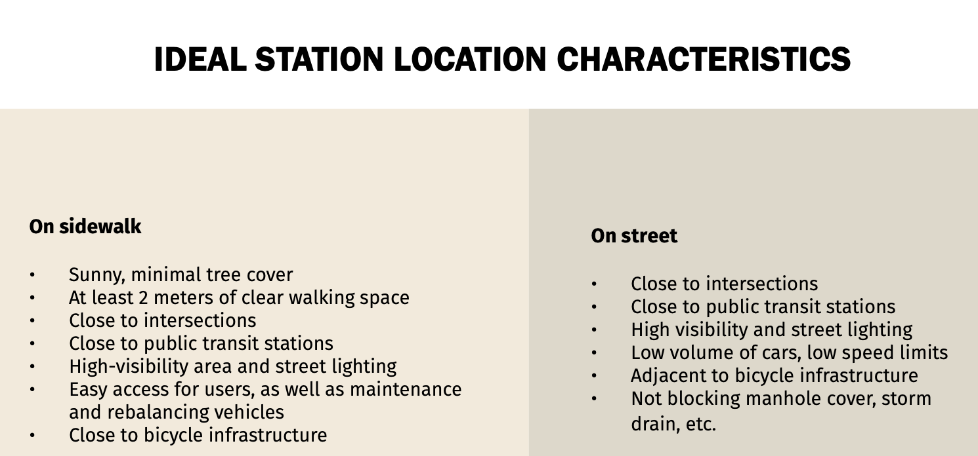
Introduction – Existing Methodology
Hannah DeBruin

Slide 6

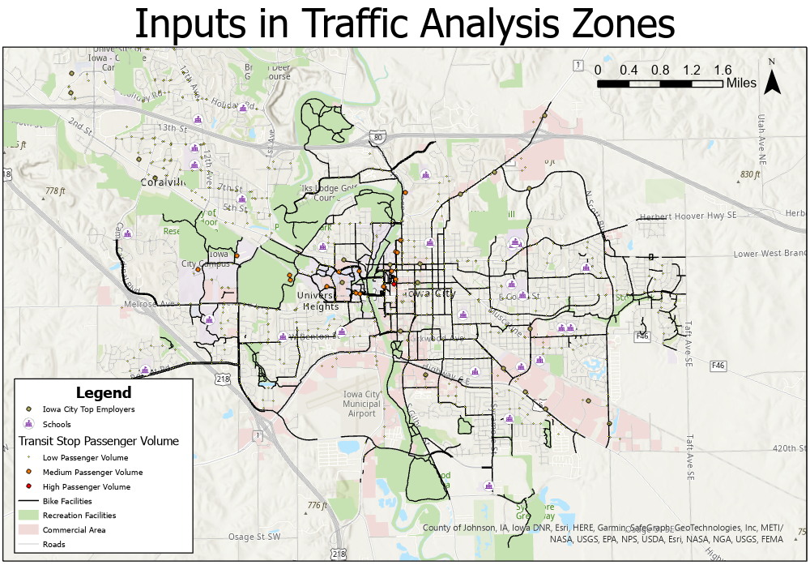
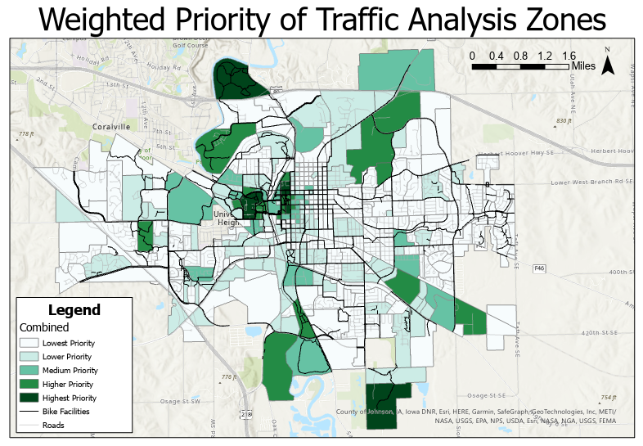
My Methodology Overview
Hannah DeBruin

Slide 7
My Methodology Overview
(same cell size, extent, snap raster)
Original Vector Data for Factor A
Rasterized Data for Factor A
Normalized Data for Factor A
Direct polygon to raster
X 10/max(A)
X % weight of factor A
Original Vector Data for Factor B
inverse Euclidean distance, buffered to 0.25 mile
Rasterized Data for Factor B
Normalized Data for Factor B
Combined Data with Spatial Index
X 10/max(B)
X % weight of factor B
inverse Euclidean distance, buffered to 0.25 mile X value of interest
X % weight of factor C
Original Vector Data for Factor C
Rasterized Data for Factor C
Normalized Data for Factor C
X 10/max(C)
Hannah DeBruin

Slide 8
Input Factors and Data Available
File | Data Type
Transit Stops (with 2019 average daily boarding (ADB) ridership data) | Points
K-12 Schools (with # student) | Points
Top Employers for Iowa City (with # employees) | Originally points, digitized into polygons
Bike Facilities for Iowa City | Polylines
Traffic Analysis Zones (2018) (with # households, student residences) | Polygons
Recreation Facilities | Polygons
Commercial Areas (with # daily trips generated on average) | Polygons
Hannah DeBruin

Slide 9
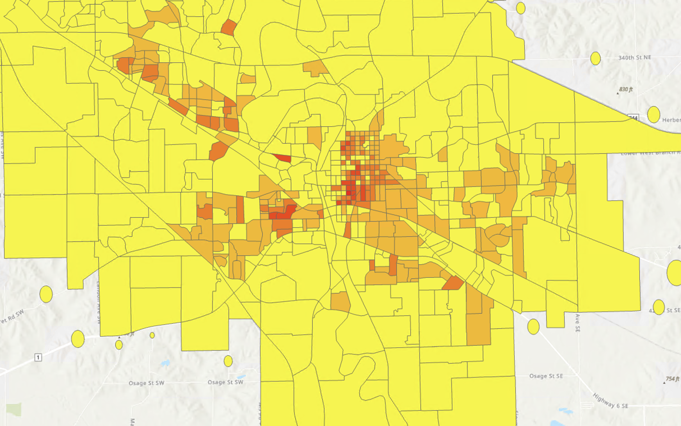
Input Factors – Household Density
Hannah DeBruin

Slide 10
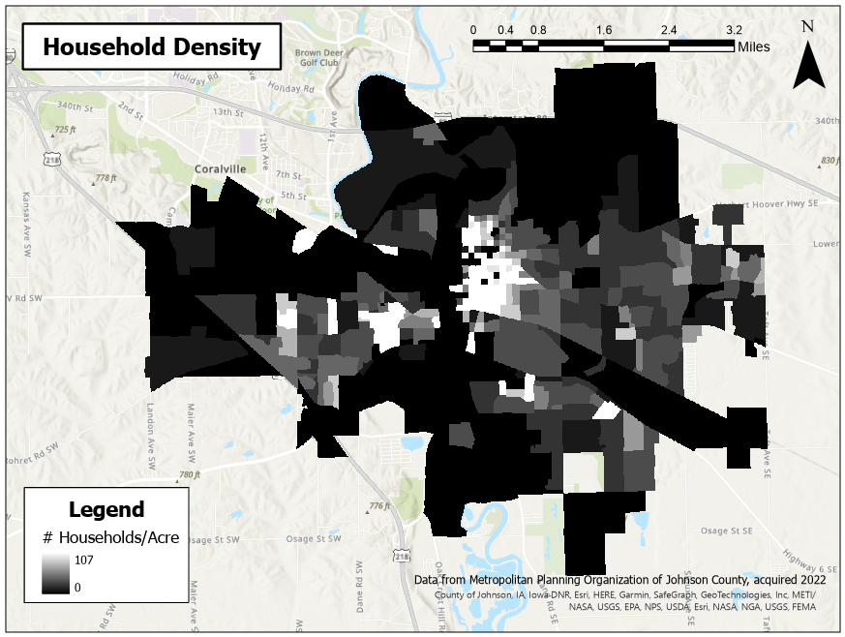

Slide 11
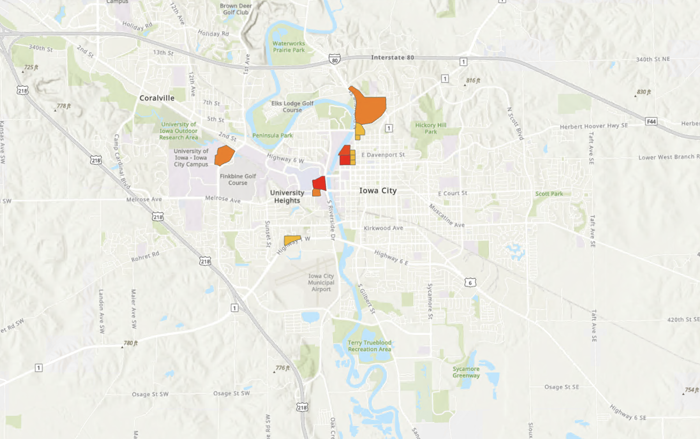
Input Factors – Proximity to Student Dorms
Hannah DeBruin

Slide 12
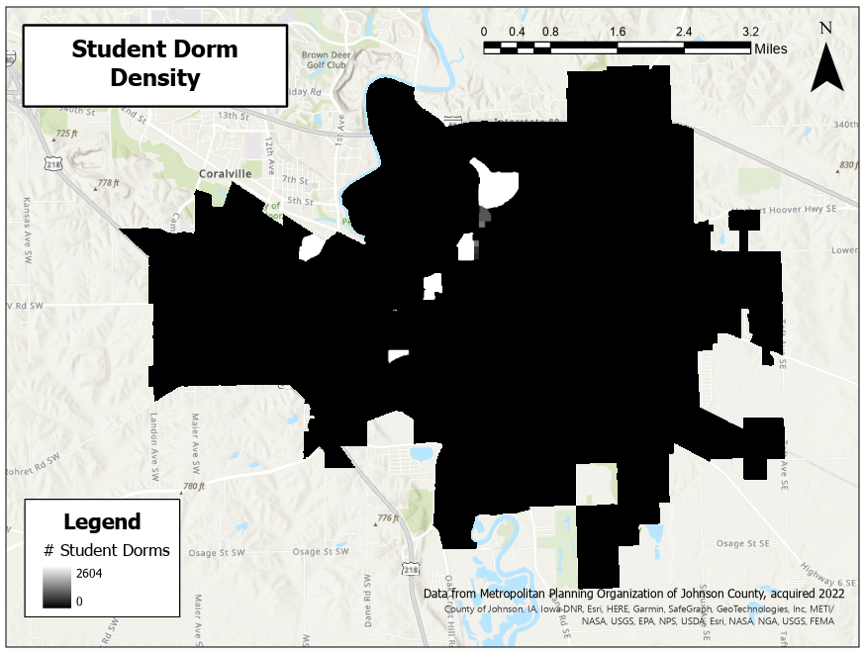

Slide 13
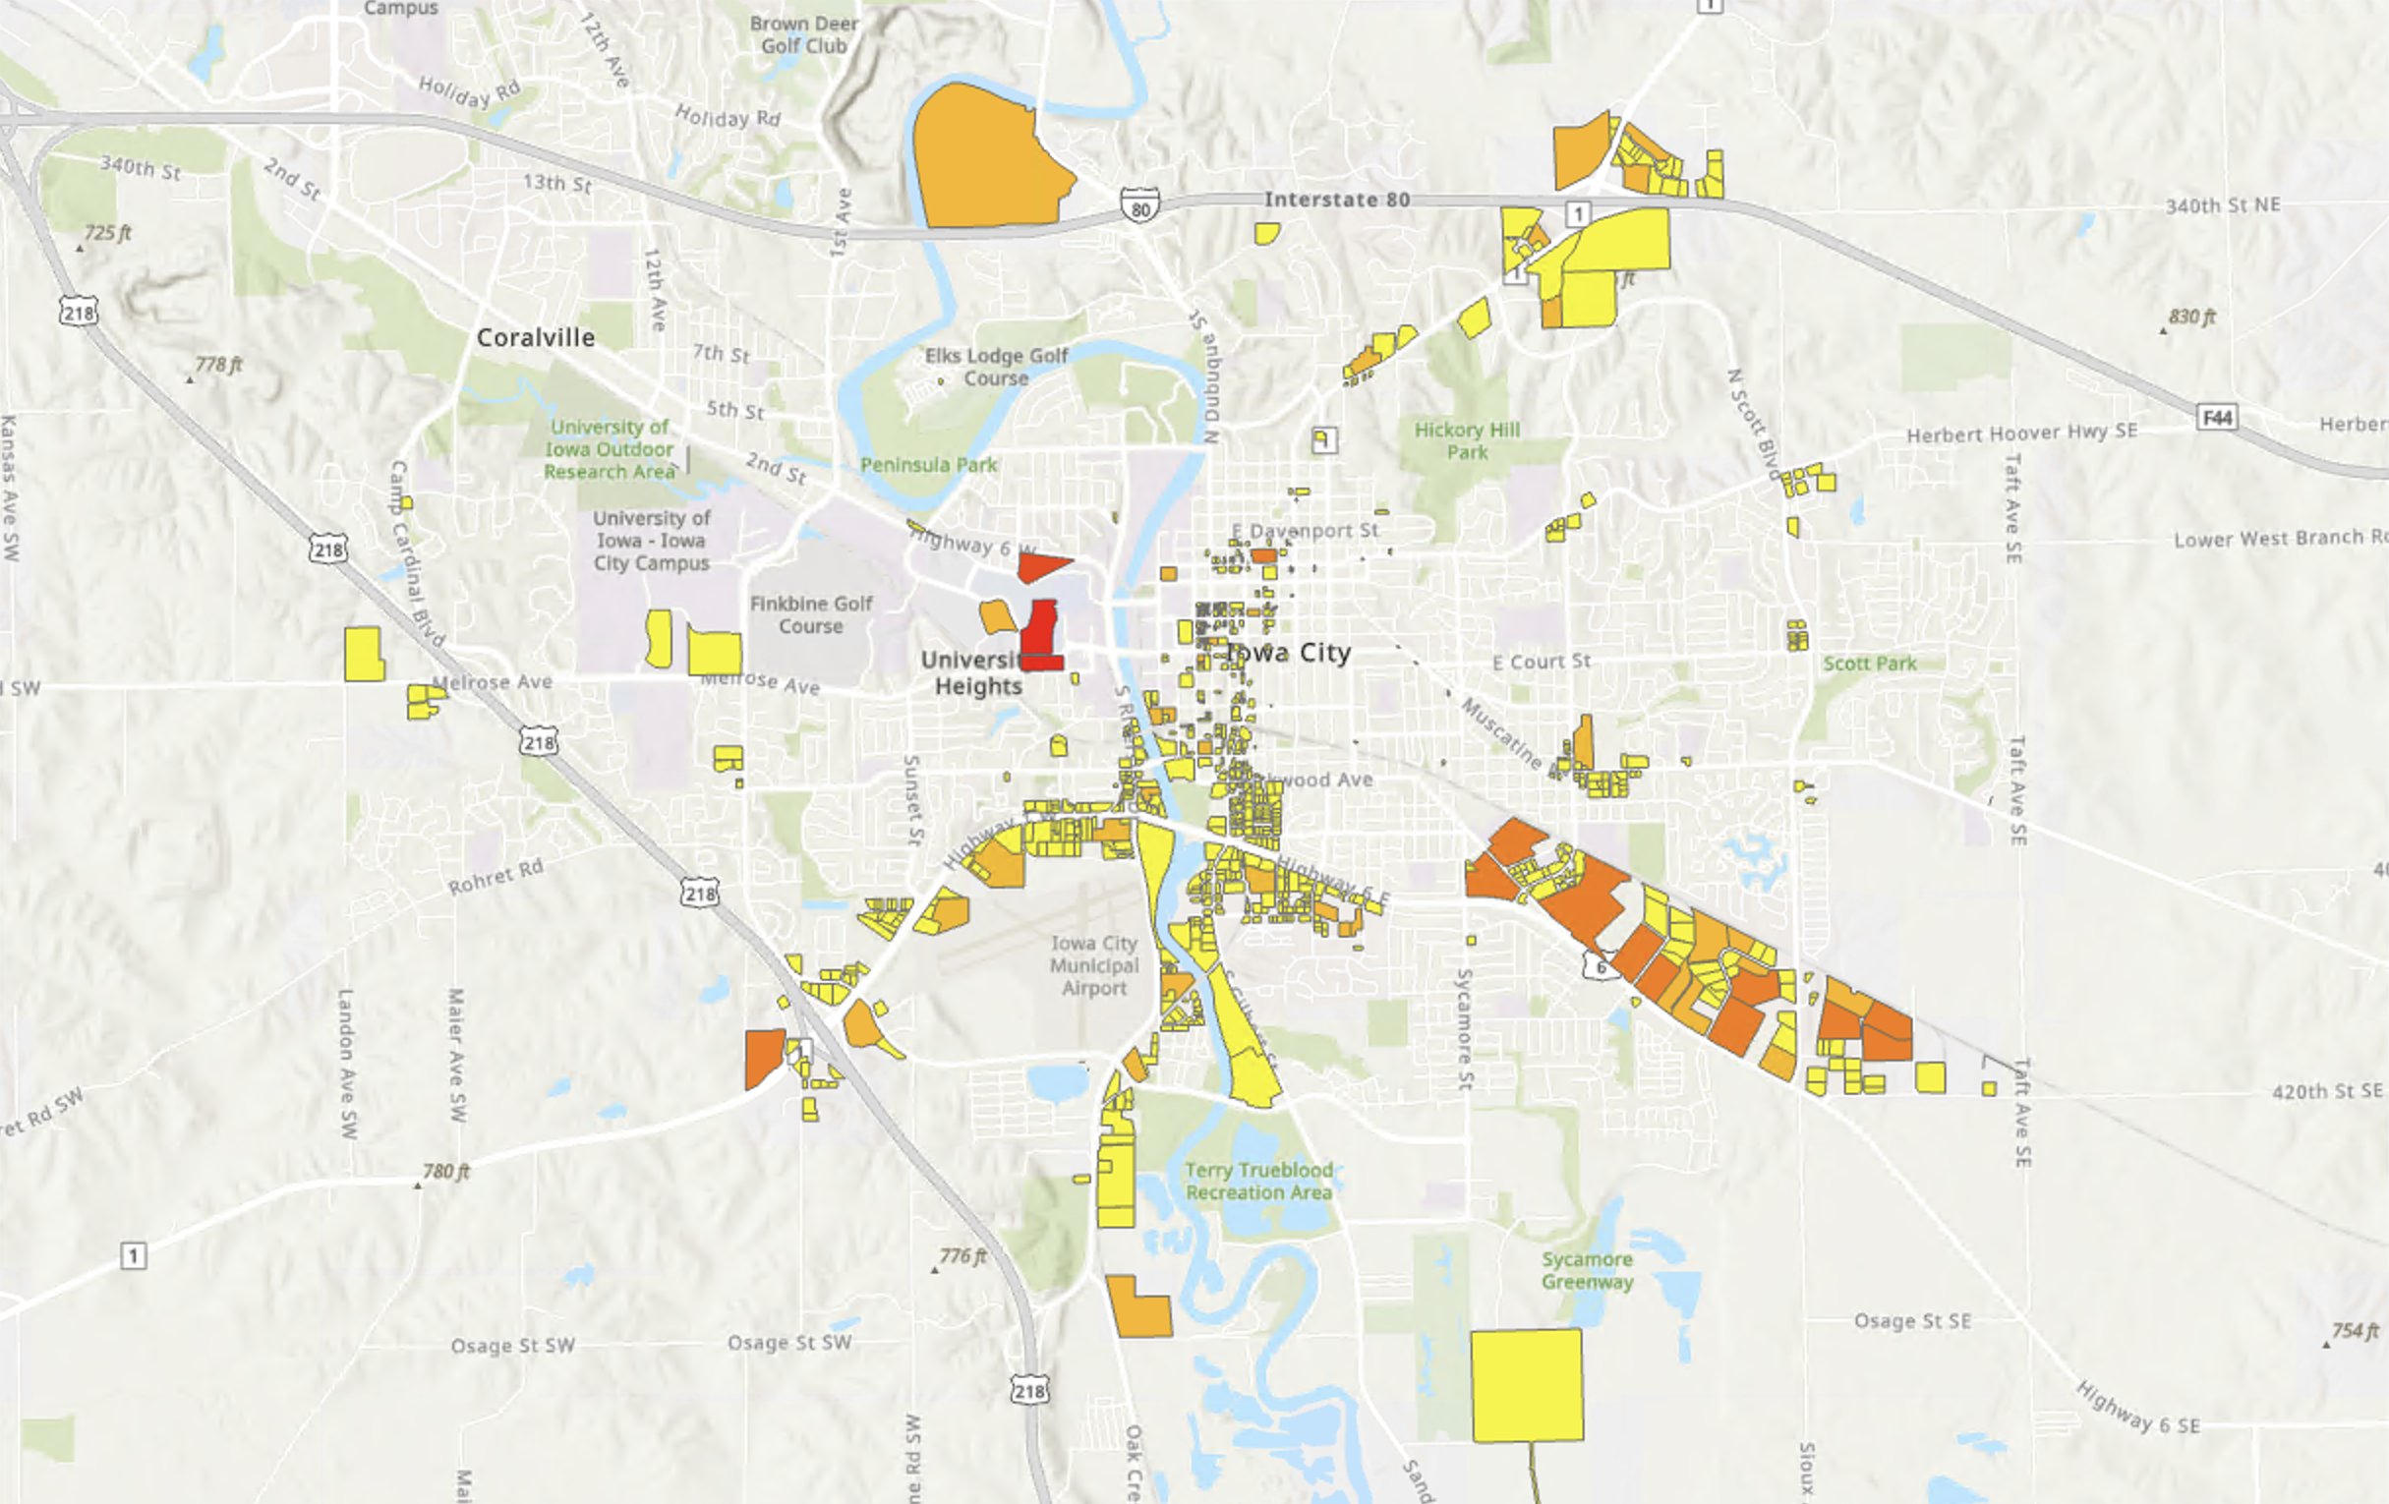
Input Factors – Proximity to Commercial Parcels*
*Weighted by AMT
Hannah DeBruin

Slide 14
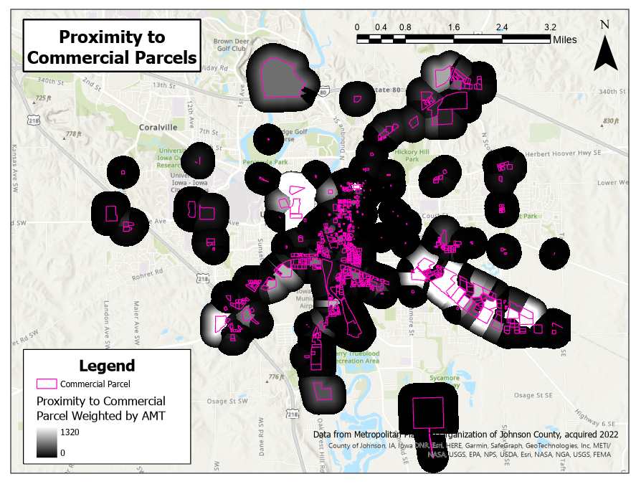
inverse distance X AMT / MAX(AMT)

Slide 15
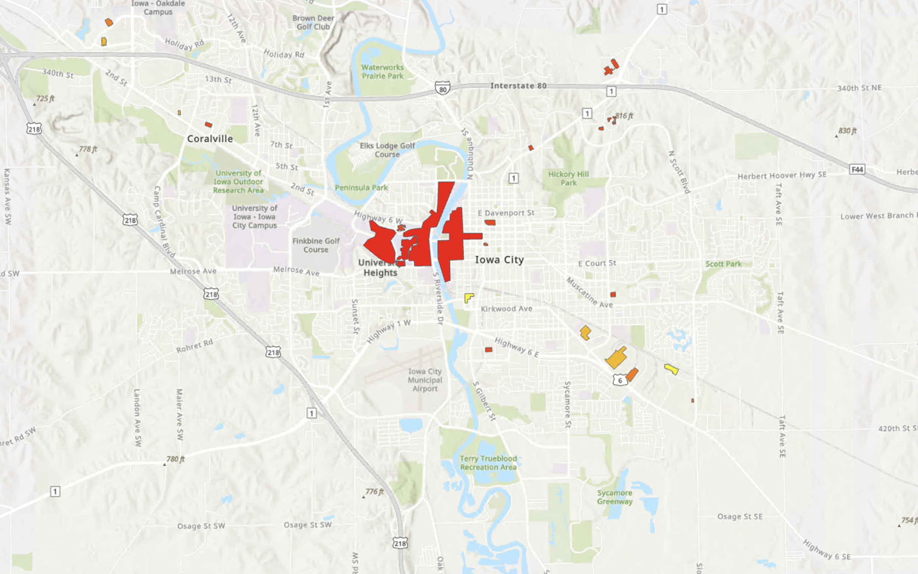
Input Factors – Proximity to Top Employer Campuses*
*Weighted by # Employees
Hannah DeBruin

Slide 16
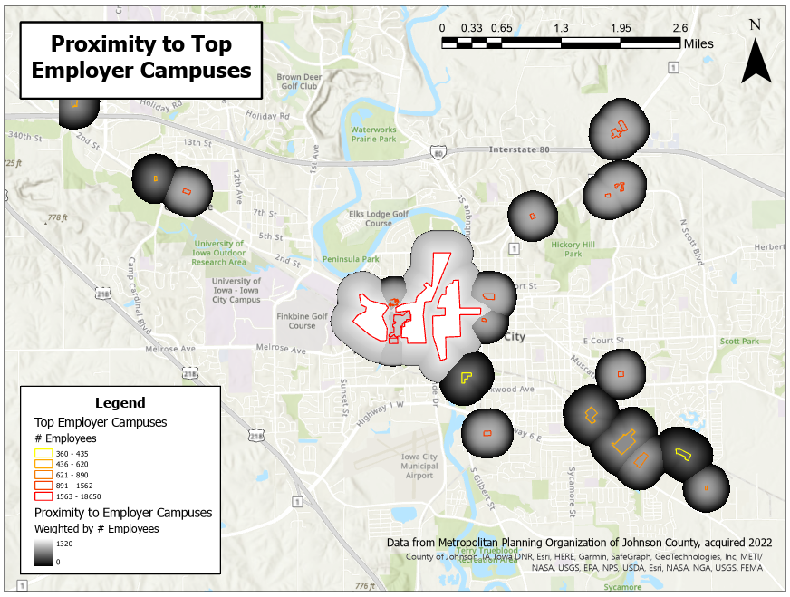
inverse distance X
Emp / MAX(Emp)

Slide 17
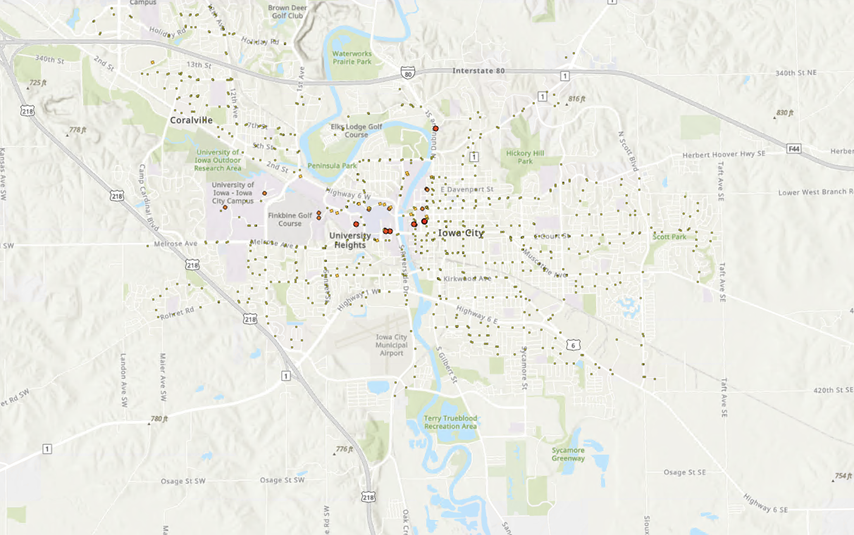
Input Factors – Proximity to Transit Stops*
*Weighted by 2019 ADB
Hannah DeBruin

Slide 18
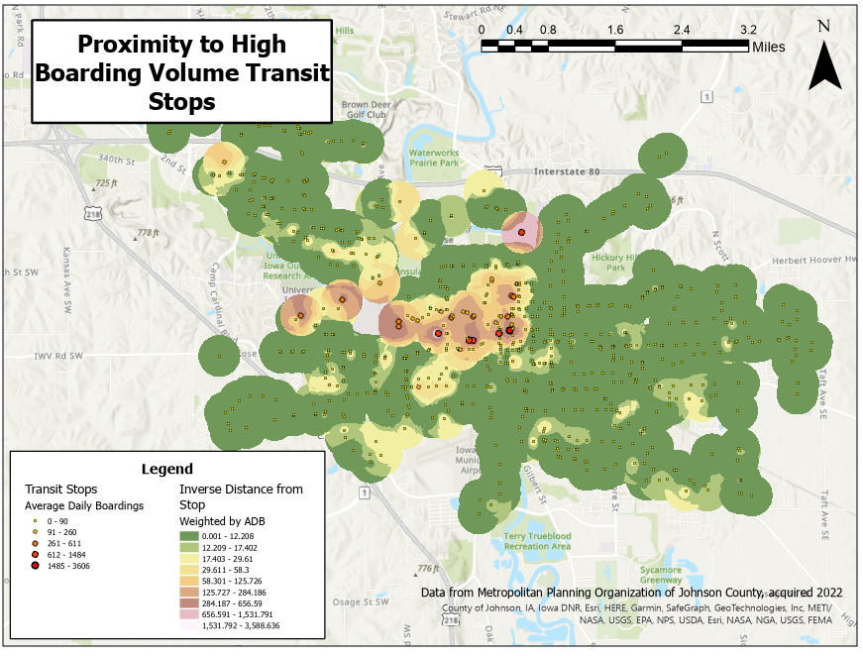

Slide 19
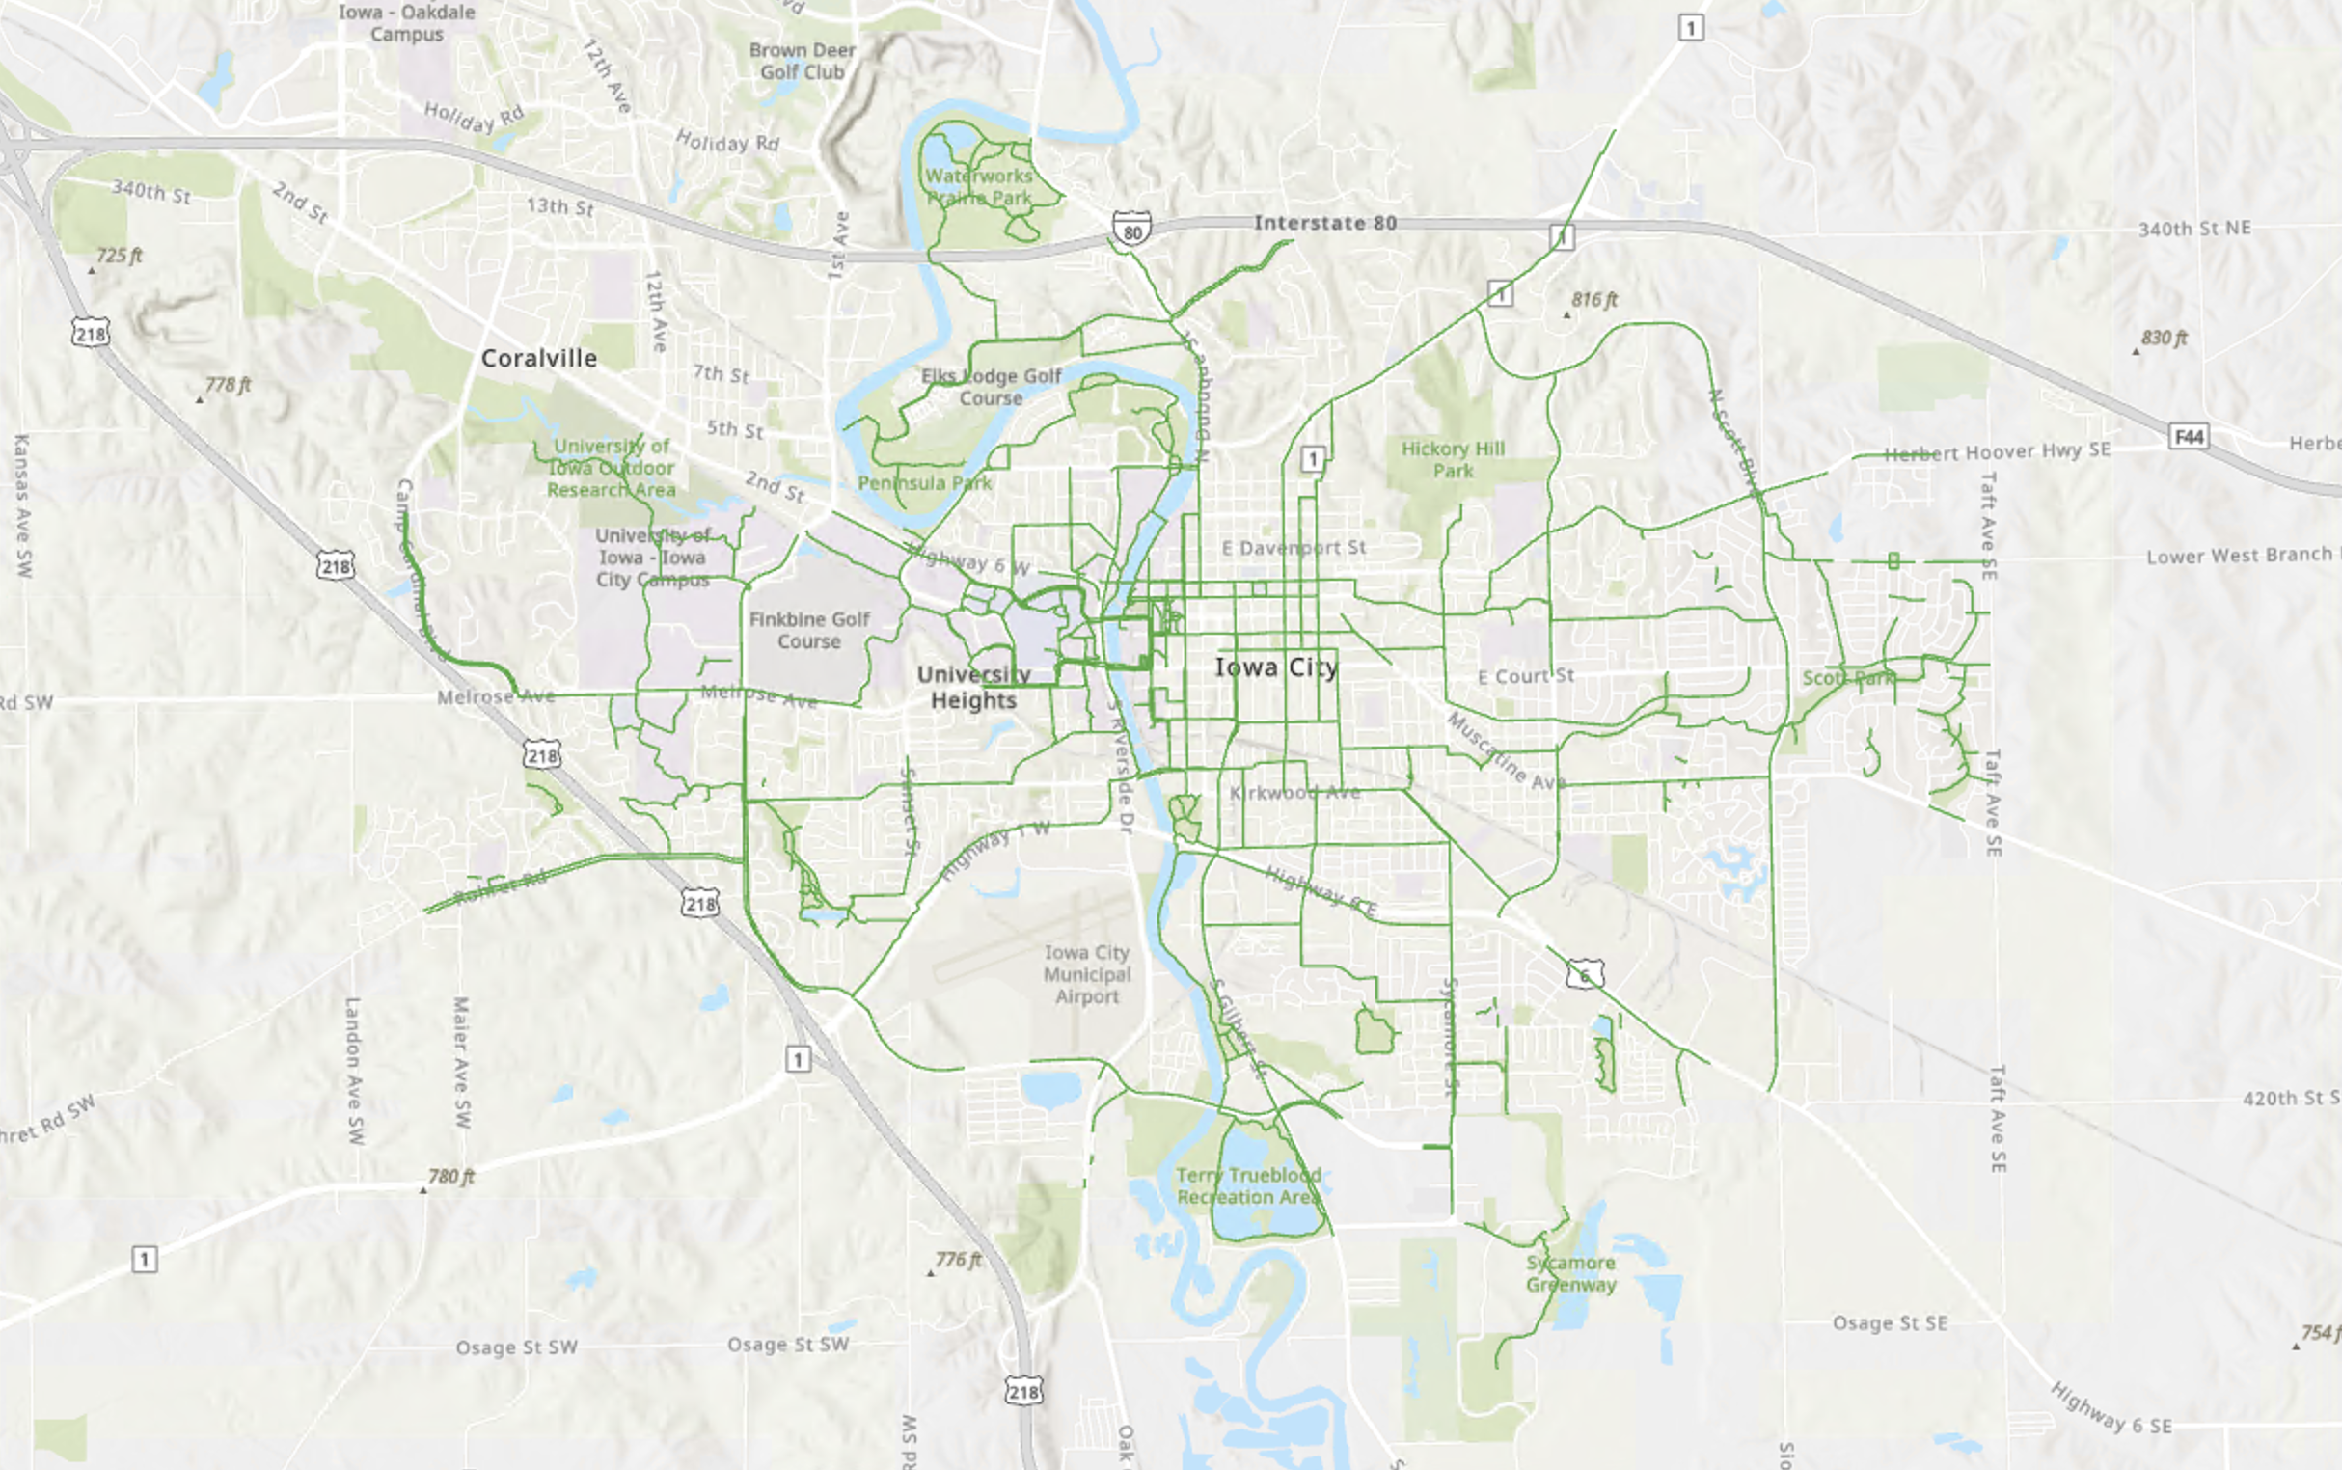
Input Factors – Proximity to Bike Facilities
Hannah DeBruin

Slide 20
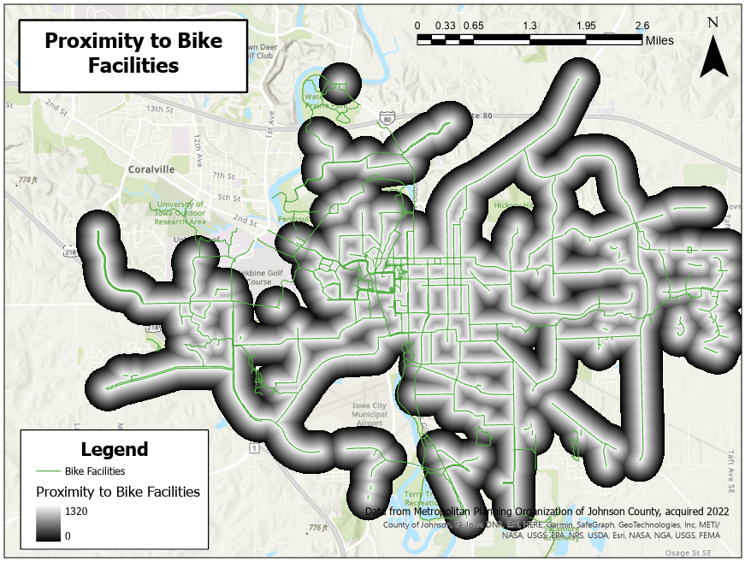
Notes:
Didn’t include local trails through parks so I wouldn’t double count

Slide 21
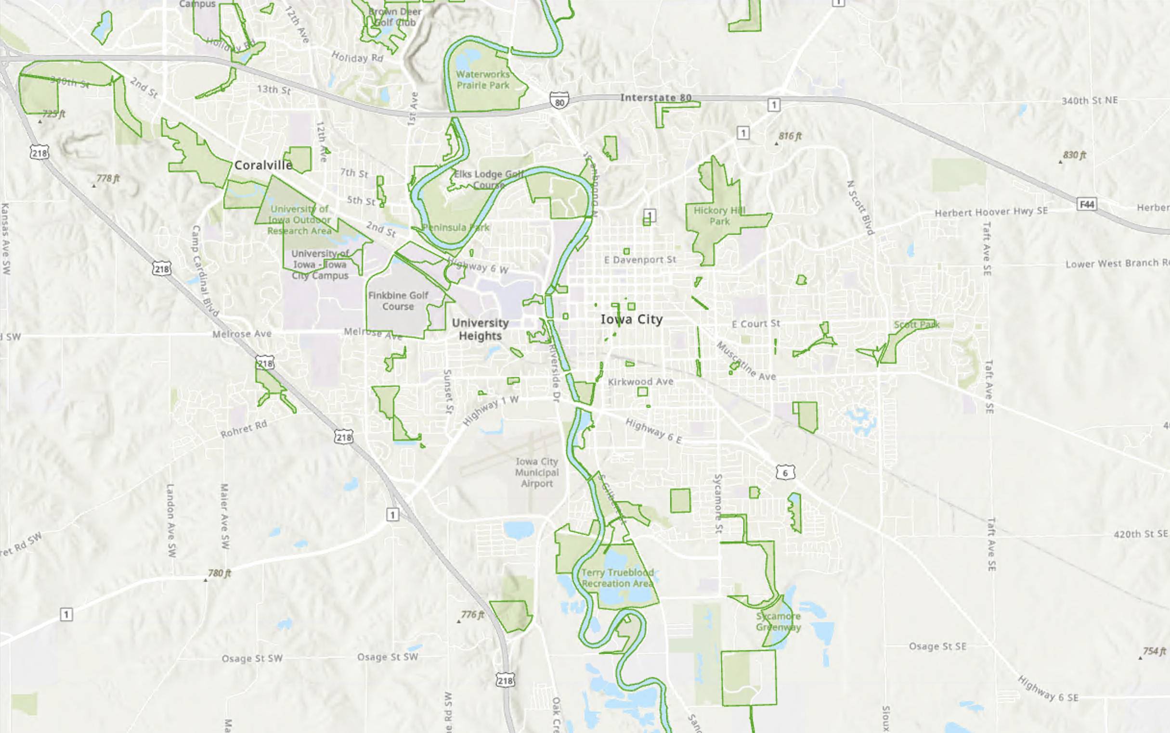
Input Factors – Proximity to Recreational Facilities
Hannah DeBruin

Slide 22
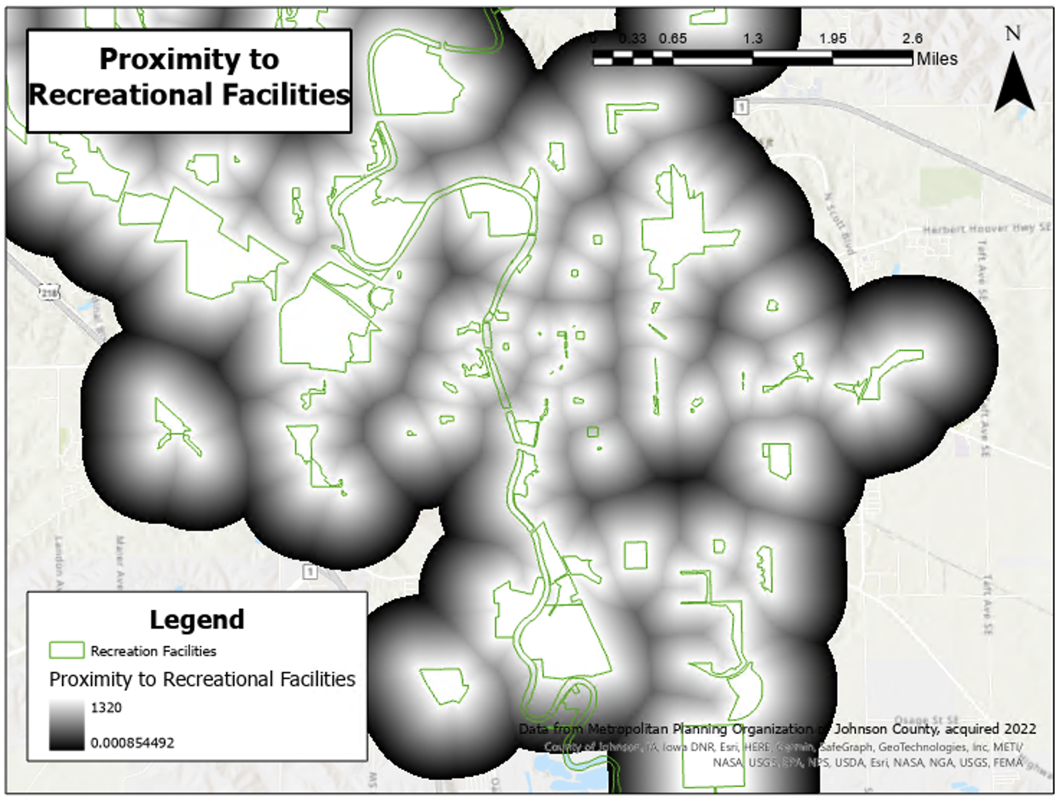

Slide 23
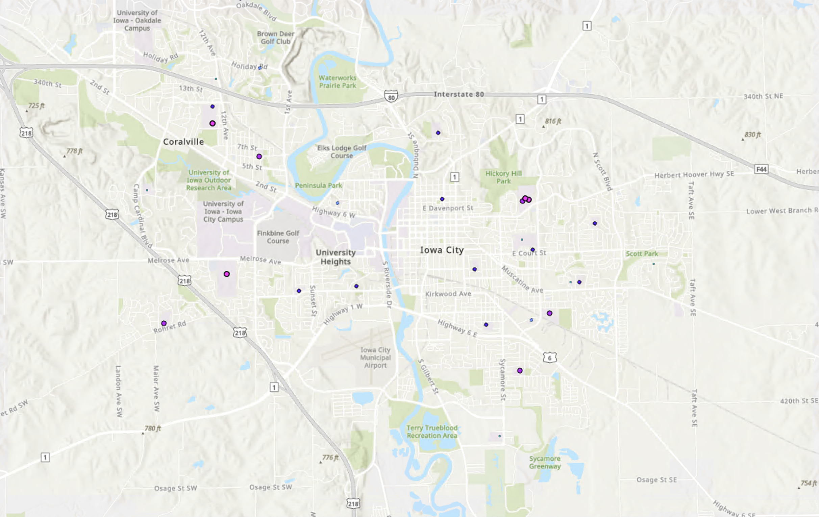
Input Factors – Proximity to K-12 Schools*
*Weighted by # Students
Hannah DeBruin

Slide 24
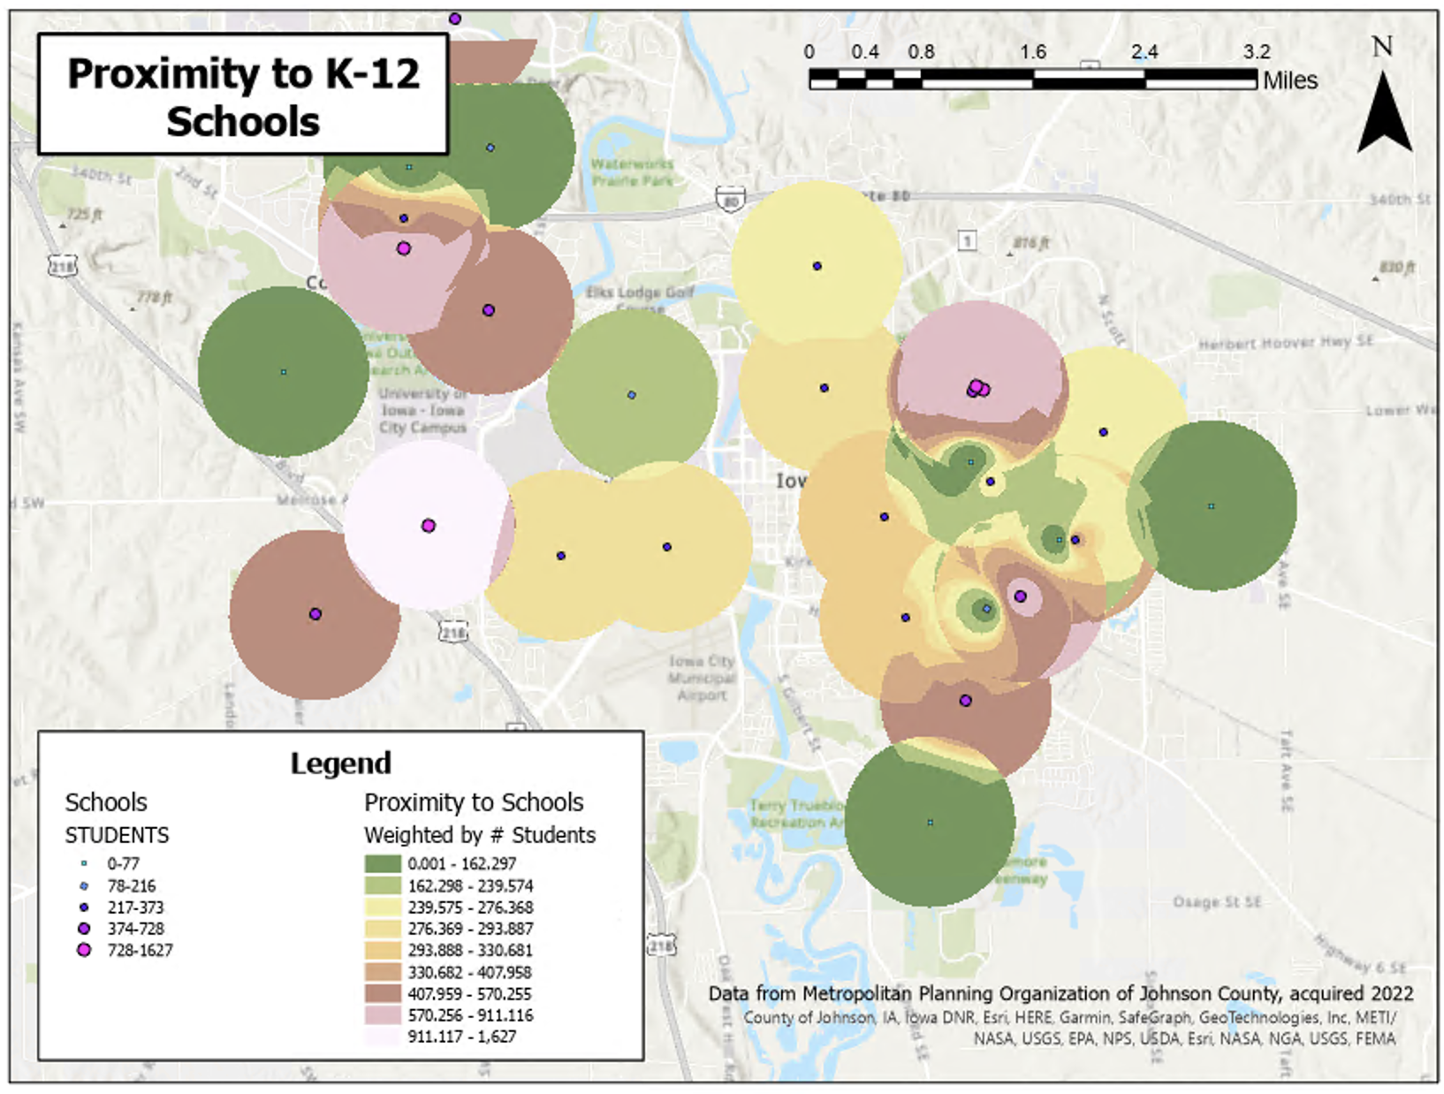

Slide 25
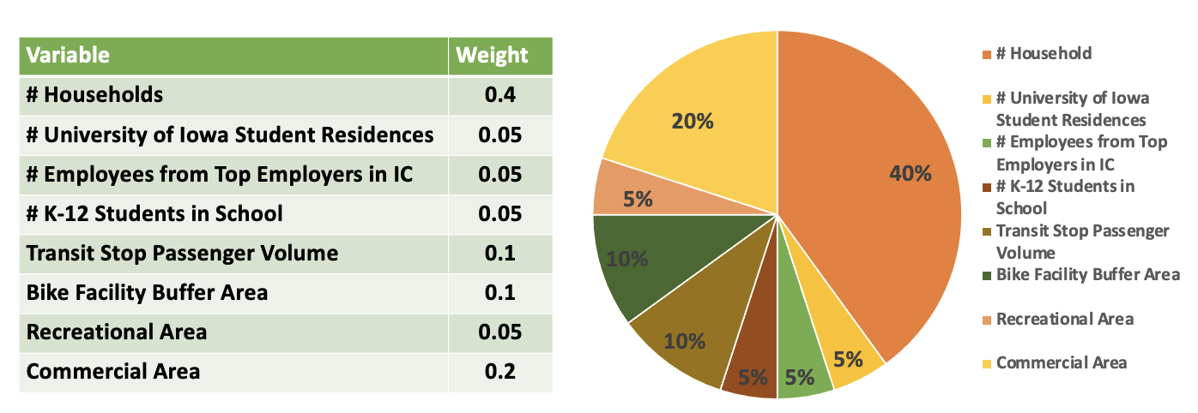
How important is each input factor?
Hannah DeBruin

Slide 26
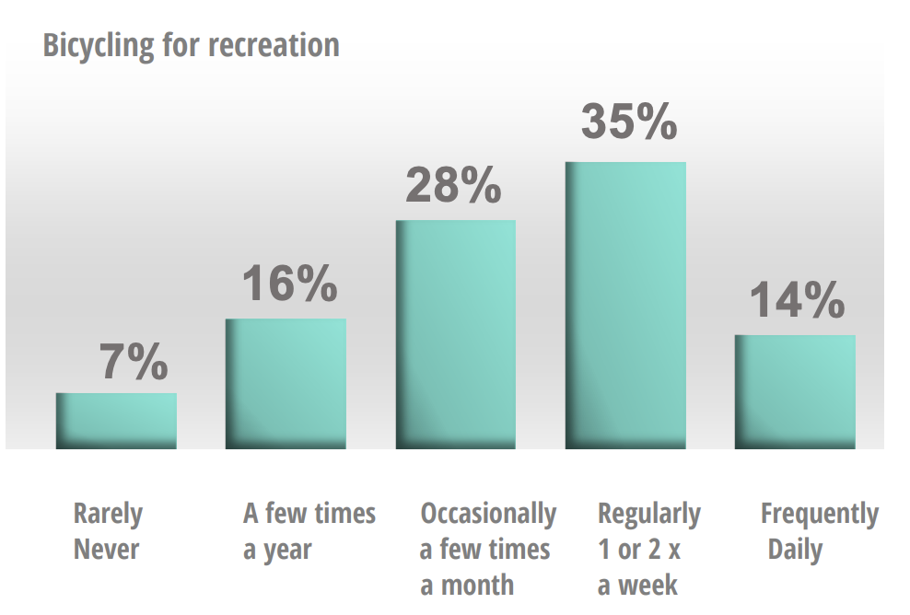

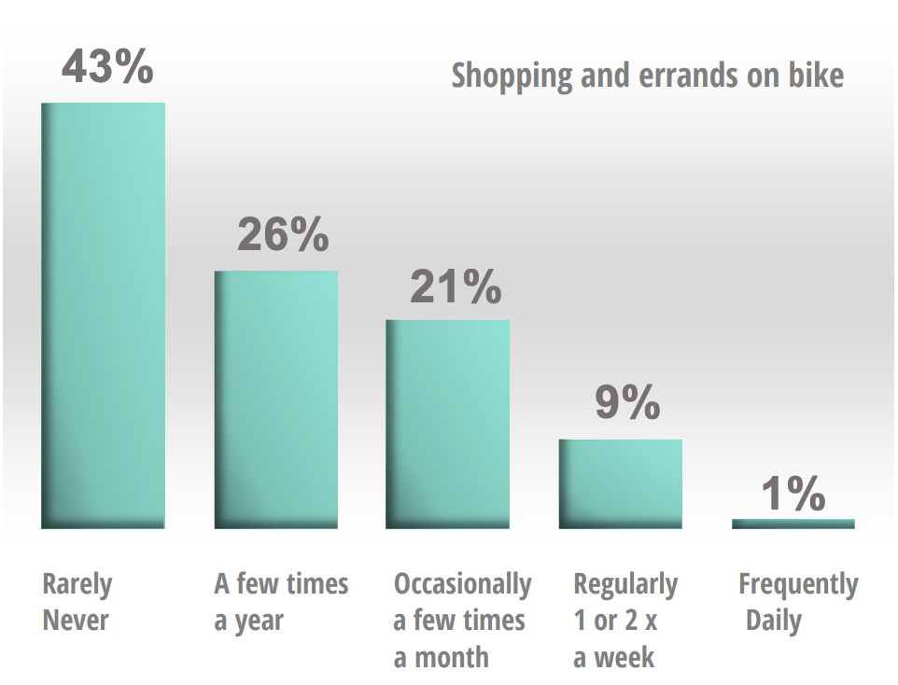
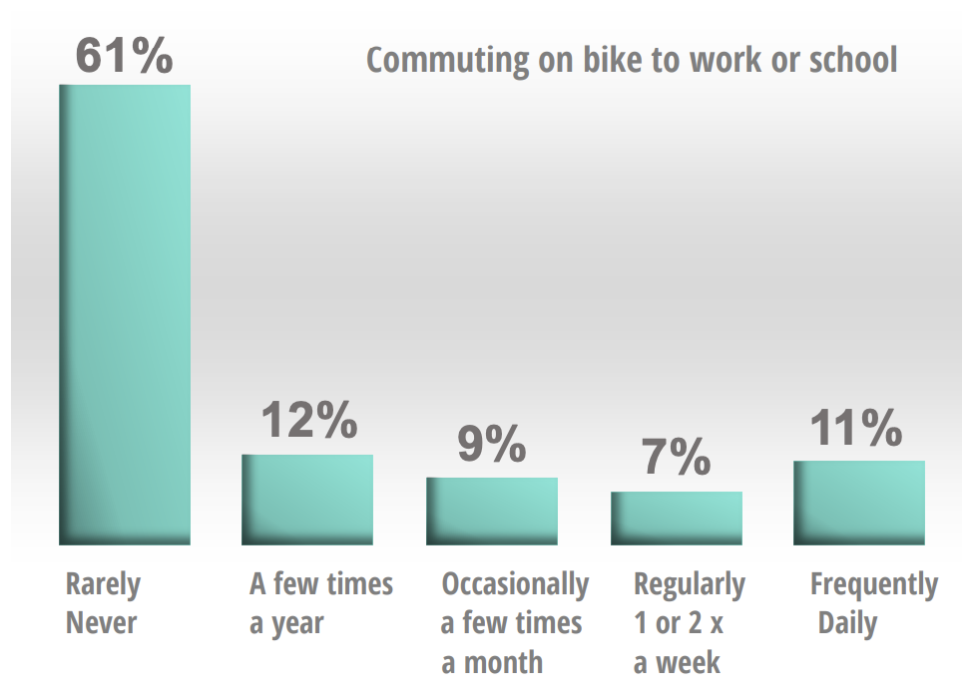
How important is each input factor?
Hannah DeBruin

Slide 27

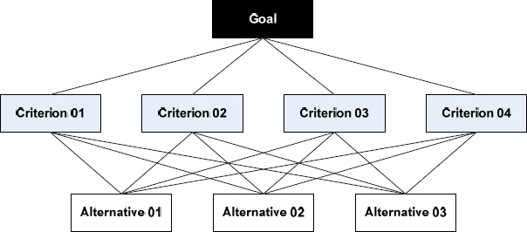
Better to determine weights through survey of professionals!
Test Survey:
Pairwise comparisons of the different factors’ influence
Analytic Hierarchy Process will be performed to determine weights
Hannah DeBruin

Slide 28
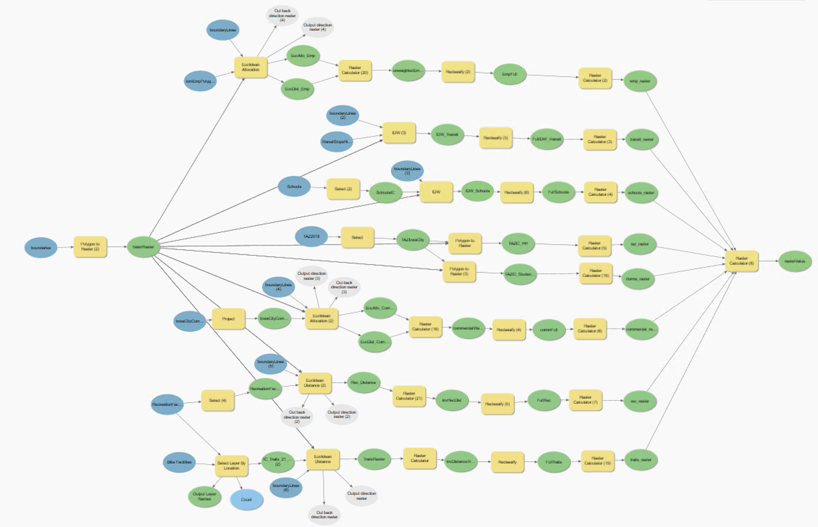
Results – Ran All Steps through GIS Model Builder
Hannah DeBruin

Slide 29
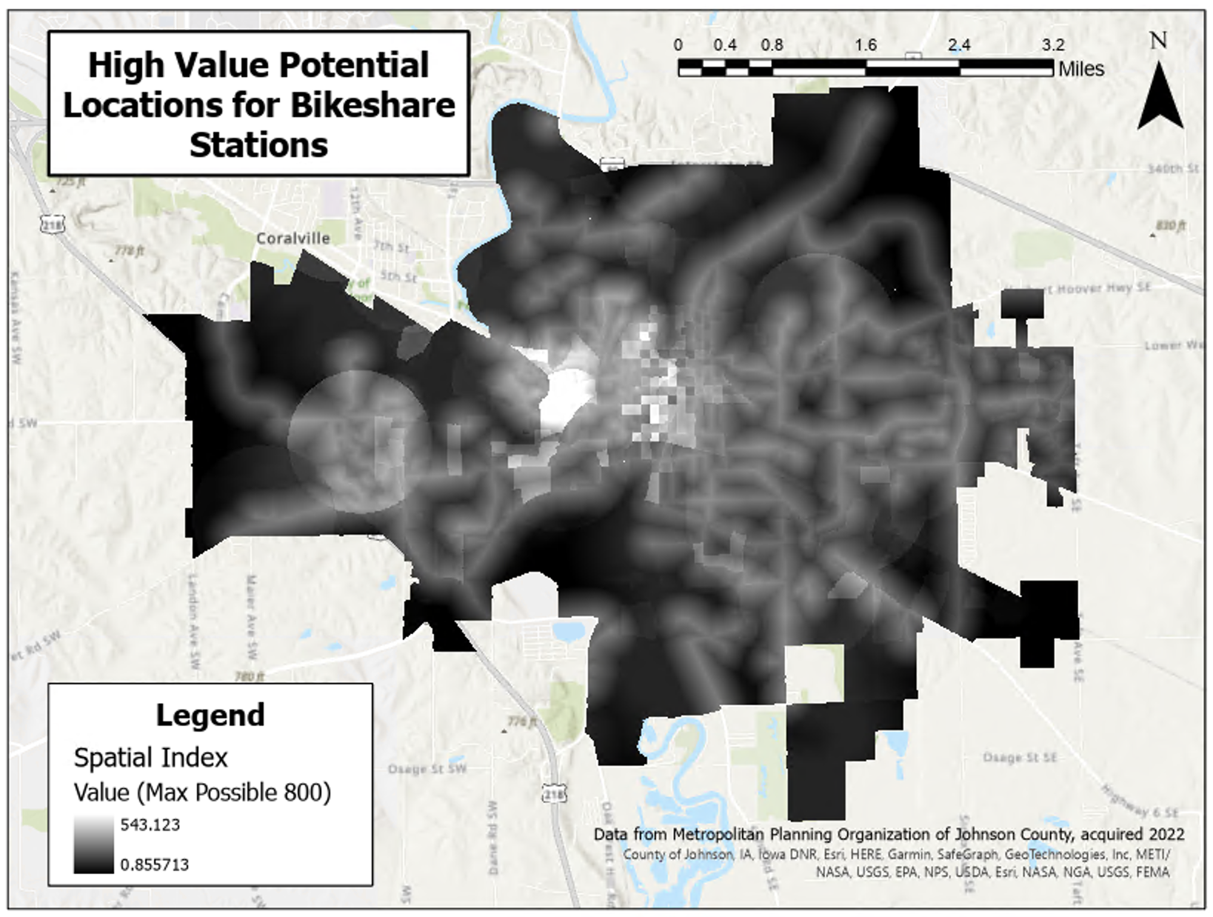

Slide 30
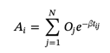
Future Improvement
Formulate optimization problem to select specific candidate locations given a constrained number of stations and minimum distance between stations
Improve weights based on survey results using analytic hierarchy process
Survey data
Inclusion of factors addressing equity (prioritization for communities identified as disadvantaged)
American Community Survey Data on median household income, household car ownership, percentage minority race
Consider factor addressing potential accessibility improvements using Hansen’s Formula
Longitudinal Employer-Household Dynamics (LEHD) Database on low-wage jobs, grocery stores, hospitals, and schools
Look into bikeshare’s capacity to compliment versus compete with transit to determine if there’s a better way to place stations near transit stops
Validate results through conversations with city/MPO transportation staff
Hannah DeBruin

Slide 31

Thank you for your time!

